Slide 1
Application Environment, Configuration and Security 25%
Discover and use resources that extend Kubernetes (CRD, Operators)
Understand authentication, authorization and admission control
Understand requests, limits, quotas
Understand ConfigMaps
Define resource requirements
Create & consume Secrets
Understand ServiceAccounts
Understand Application Security (SecurityContexts, Capabilities, etc.)

Slide 2
Application Environment, Configuration and Security 25%
Discover and use resources that extend Kubernetes (CRD, Operators)
Understand authentication, authorization and admission control
Understand requests, limits, quotas
Understand ConfigMaps
Define resource requirements
Create & consume Secrets
Understand ServiceAccounts
Understand Application Security (SecurityContexts, Capabilities, etc.)
Notes:
I am not sure, you will get some question from these topics. So, let’s jump into the 3rd topic.

Slide 3
Application Environment, Configuration and Security 25%
Discover and use resources that extend Kubernetes (CRD, Operators)
Understand authentication, authorization and admission control
Understand requests, limits, quotas
Understand ConfigMaps
Define resource requirements
Create & consume Secrets
Understand ServiceAccounts
Understand Application Security (SecurityContexts, Capabilities, etc.)

Slide 4
Question: kubectl config use-context ek8s
Create a pod that requests a certain amount of CPU and memory.
Complete the task:
- Create a namespace project-one
- Create a POD named nginx-resources in the project-one namespace that required a minimum of 200m CPU and 1Gi memory for its container
Requests and limits
Requests means minimum amount of resource it can consume (request). Kubernetes Schedular will check the node if it can
create a pod with this minimum resource?
Limits: It means, maximum amount of request container can demand. The kubelet (and container runtime) enforce the limit.
If application inside the container demands more resources (example allowed amount of memory), then the system kernel
terminates the process that attempted the allocation, with an out of memory (OOM) error.

Slide 5
Question: kubectl config use-context ek8s
Create a pod that requests a certain amount of CPU and memory.
Complete the task:
- Create a namespace project-one
- Create a POD named nginx-resources in the project-one namespace that required a minimum of 200m CPU and 1Gi memory for its container
- The pod should use the nginx image.
Limits and requests for CPU resources are measured in cpu units. In Kubernetes, 1 CPU unit is equivalent to 1 physical CPU core, or 1 virtual core, depending on whether the node is a physical host or a virtual machine running inside a physical machine.
Limits and requests for memory are measured in bytes. You can express memory as a plain integer or as a fixed-point
500 mebibytes = 500Mi = 400 megabytes

Slide 6

Question: kubectl config use-context ek8s
Create a pod that requests a certain amount of CPU and memory.
Complete the task:
- Create a namespace project-one
- Create a POD named nginx-resources in the project-one namespace that required a minimum of 200m CPU and 1Gi memory for its container
- The pod should use the nginx image.
cat > q3-pod.yaml
apiVersion: v1 kind: Pod metadata: name: nginx-resources namespace: project-one spec: containers: - name: app image: nginx resources: requests: memory: "1Gi" cpu: "200m"
kubectl config use-context ek8s
kubectl create ns project-one
kubectl create -f q3-pod.yaml
kubectl get pod -n project-one
kubectl -n project-one describe pod/nginx-resources | grep -A 2 -i Requests
Requests:
cpu: 200m
memory: 1Gi

Slide 7
Application Environment, Configuration and Security 25%
Discover and use resources that extend Kubernetes (CRD, Operators)
Understand authentication, authorization and admission control
Understand requests, limits, quotas
Understand ConfigMaps
Define resource requirements
Create & consume Secrets
Understand ServiceAccounts
Understand Application Security (SecurityContexts, Capabilities, etc.)

Slide 8
Application Environment, Configuration and Security 25%
Discover and use resources that extend Kubernetes (CRD, Operators)
Understand authentication, authorization and admission control
Understand requests, limits, quotas
Understand ConfigMaps
Define resource requirements
Create & consume Secrets
Understand ServiceAccounts
Understand Application Security (SecurityContexts, Capabilities, etc.)

Slide 9
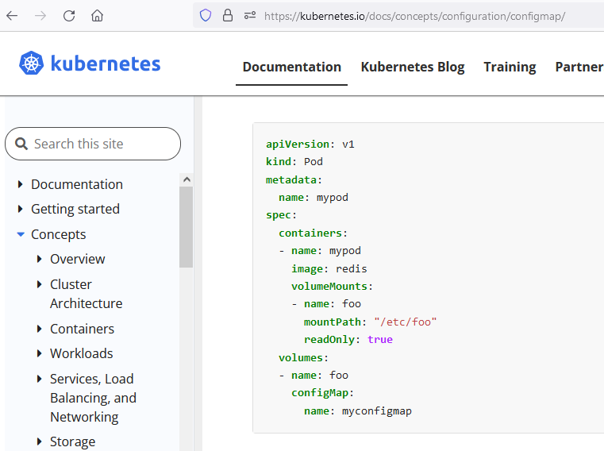
you are tasked to create a ConfigMap and consume the ConfigMap in a pod using a volume mount.
Task need to be completed:
- Create a configMap named another-config containing the key/value pair. key7/value5.
- Create a pod named nginx-configmap and should have nginx image and mount the key you just created into the pod under directory /data/config
Use: kubectl config use-context ek8s
: Open the https://kubernetes.io/ , click on documentation , search configMap
kubectl config use-context ek8s
kubectl create configmap another-config --from-literal=key7=value5

Slide 10
you are tasked to create a ConfigMap and consume the ConfigMap in a pod using a volume mount.
Task need to be completed:
- Create a configMap named another-config containing the key/value pair. key7/value5.
- Create a pod named nginx-configmap and should have nginx image and mount the key you just created into the pod under directory /data/config
Use: kubectl config use-context ek8s
Solution: Open the https://kubernetes.io/ , click on documentation , search configMap
kubectl create configmap another-config --from-literal=key7=value5
cat > q4.pod.yaml
apiVersion: v1
kind: Pod
metadata:
name: nginx-configmap
spec:
containers:
- name: mypod
image: nginx
volumeMounts:
- name: foo
mountPath: "/data/config"
volumes:
- name: foo
configMap:
name: another-config

Slide 11
you are tasked to create a ConfigMap and consume the ConfigMap in a pod using a volume mount.
Task need to be completed:
- Create a configMap named another-config containing the key/value pair. key7/value5.
- Create a pod named nginx-configmap and should have nginx image and mount the key you just created into the pod under directory /data/config
Use: kubectl config use-context ek8s
Solution: Open the https://kubernetes.io/ , click on documentation , search configMap
kubectl create configmap another-config --from-literal=key7=value5
cat > q4.pod.yaml
apiVersion: v1
kind: Pod
metadata:
name: nginx-configmap
spec:
containers:
- name: mypod
image: nginx
volumeMounts:
- name: foo
mountPath: "/data/config"
volumes:
- name: foo
configMap:
name: another-config
kubectl create -f q4.pod.yaml
kubectl get po
kubectl exec -it pods/nginx-configmap -- cat /data/config/key7 ; echo
value5

Slide 12
Application Environment, Configuration and Security 25%
Discover and use resources that extend Kubernetes (CRD, Operators)
Understand authentication, authorization and admission control
Understand requests, limits, quotas
Understand ConfigMaps
Define resource requirements
Create & consume Secrets
Understand ServiceAccounts
Understand Application Security (SecurityContexts, Capabilities, etc.)

Slide 13
Application Environment, Configuration and Security 25%
Discover and use resources that extend Kubernetes (CRD, Operators)
Understand authentication, authorization and admission control
Understand requests, limits, quotas
Understand ConfigMaps
Define resource requirements
Create & consume Secrets
Understand ServiceAccounts
Understand Application Security (SecurityContexts, Capabilities, etc.)

Slide 14
Application Environment, Configuration and Security 25%
Discover and use resources that extend Kubernetes (CRD, Operators)
Understand authentication, authorization and admission control
Understand requests, limits, quotas
Understand ConfigMaps
Define resource requirements
Create & consume Secrets
Understand ServiceAccounts
Understand Application Security (SecurityContexts, Capabilities, etc.)

Slide 15
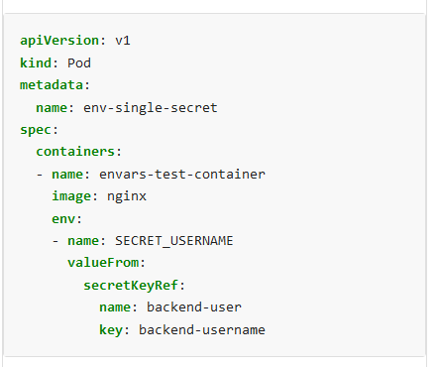
Use: Use: kubectl config use-context ek8s
You are tasked to create a secret and consume the secret in a pod using environment variables as follows
- Create a secret name app-secret1 with a key/value pair. key30/value4
- Start a nginx POD named nginx-secret1 using container image nginx and add an environment a variable exposing the value of
the secret key key30 using BEST_VARIABLE1 as the name of the environment variable inside the pod.
kubectl config use-context ek8s
kubectl create secret generic app-secret1 --from-literal=key30=value4
https://kubernetes.io/
click on documentation
search secret env

Slide 16
Use: kubectl config use-context ek8s
You are tasked to create a secret and consume the secret in a pod using environment variables as follows
- Create a secret name app-secret1 with a key/value pair. key30/value4
- Start a nginx POD named nginx-secret1 using container image nginx and add an environment a variable exposing the value of the secret key key30 using BEST_VARIABLE1 as the name of the environment variable inside the pod.
kubectl config use-context ek8s
kubectl create secret generic app-secret1 --from-literal=key30=value4
cat > q2-pod.yaml
apiVersion: v1 kind: Pod metadata: name: nginx-secret1 spec: containers: - name: mycontainer image: nginx env: - name: BEST_VARIABLE1 valueFrom: secretKeyRef: name: app-secret1 key: key30

Slide 17
Use: kubectl config use-context ek8s
You are tasked to create a secret and consume the secret in a pod using environment variables as follows
- Create a secret name app-secret1 with a key/value pair. key30/value4
- Start a nginx POD named nginx-secret1 using container image nginx and add an environment a variable exposing the value of the secret key key30 using BEST_VARIABLE1 as the name of the environment variable inside the pod.
kubectl config use-context ek8s
kubectl create secret generic app-secret1 --from-literal=key30=value4
cat > q2-pod.yaml
apiVersion: v1 kind: Pod metadata: name: nginx-secret1 spec: containers: - name: mycontainer image: nginx env: - name: BEST_VARIABLE1 valueFrom: secretKeyRef: name: app-secret1 key: key30
[root@master1 data]# kubectl create -f q2-pod.yaml
[root@master1 data]# kubectl get pods/nginx-secret1
NAME READY STATUS RESTARTS AGE
nginx-secret1 1/1 Running 0 56m
[root@master1 data]# kubectl exec -it pods/nginx-secret1 -- printenv | grep BEST
BEST_VARIABLE1=value4

Slide 18
Application Environment, Configuration and Security 25%
Discover and use resources that extend Kubernetes (CRD, Operators)
Understand authentication, authorization and admission control
Understand requests, limits, quotas
Understand ConfigMaps
Define resource requirements
Create & consume Secrets
Understand ServiceAccounts
Understand Application Security (SecurityContexts, Capabilities, etc.)

Slide 19
Application Environment, Configuration and Security 25%
Discover and use resources that extend Kubernetes (CRD, Operators)
Understand authentication, authorization and admission control
Understand requests, limits, quotas
Understand ConfigMaps
Define resource requirements
Create & consume Secrets
Understand ServiceAccounts
Understand Application Security (SecurityContexts, Capabilities, etc.)

Slide 20
Use: kubectl config use-context ek8s
There is one deployment web-app is running under namespace project-production
Task need to be performed:
Update the web-app deployment to run as an app serviceaccount. This serviceaccount is already created.
[root@master1 data]# kubectl config use-context ek8s
[root@master1 data]# kubectl -n project-production describe deployments/web-app | grep -i Service
[root@master1 data]#
[root@master1 data]# kubectl edit deployment web-app -n project-production
https://kubernetes.io/
click on documentation
search serviceAccount

Slide 21
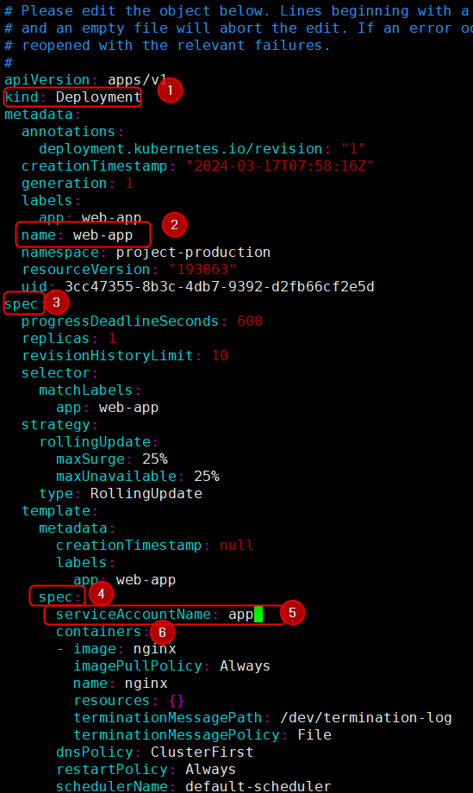

Slide 22
Use: kubectl config use-context ek8s
There is one deployment web-app is running under namespace project-production
Task need to be performed:
Update the web-app deployment to run as an app serviceaccount. This serviceaccount is already created.
[root@master1 data]# kubectl config use-context ek8s
[root@master1 data]# kubectl -n project-production describe deployments/web-app | grep -i Service
[root@master1 data]#
[root@master1 data]# kubectl edit deployment web-app -n project-production
[root@master1 data]# kubectl -n project-production describe deployments/web-app | grep Service
Service Account: app
https://kubernetes.io/
click on documentation
search serviceAccount

Slide 23
Want to practice at home for this question?
kubectl create ns project-production
kubectl create deployment web-app --image=nginx -n project-production
kubectl create sa app -n project-production
kubectl edit deployment web-app -n project-production

Slide 24
Application Environment, Configuration and Security 25%
Discover and use resources that extend Kubernetes (CRD, Operators)
Understand authentication, authorization and admission control
Understand requests, limits, quotas
Understand ConfigMaps
Define resource requirements
Create & consume Secrets
Understand ServiceAccounts
Understand Application Security (SecurityContexts, Capabilities, etc.)

Slide 25
Application Environment, Configuration and Security 25%
Discover and use resources that extend Kubernetes (CRD, Operators)
Understand authentication, authorization and admission control
Understand requests, limits, quotas
Understand ConfigMaps
Define resource requirements
Create & consume Secrets
Understand ServiceAccounts
Understand Application Security (SecurityContexts, Capabilities, etc.)

